Slide 1

CHIMERA

Slide 2

The
Pigment
Problem
CHIMERA
CHIMERA
PRICE
High manufacturing costs for high quality pigments.
PERFORMANCE
Color Specificity, stability and ease-of-use are hard to achieve with current technology.
POLLUTANTS
Unsustainable manufacturing; largest contributor to toxic wastewater production. Third largest in land and water use, fourth largest carbon footprint.

Slide 3
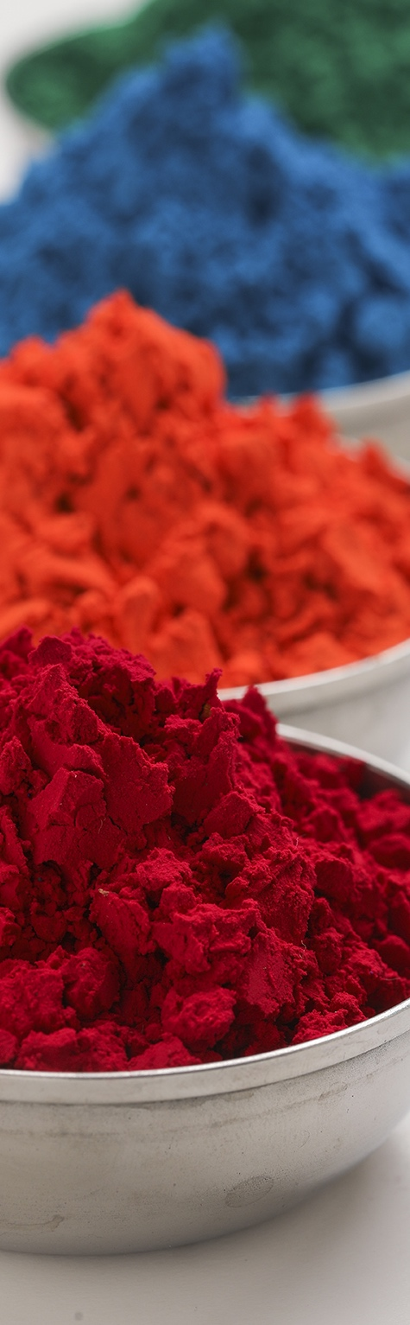
The
Chimera
Solution.
CHIMERA
SPEED TO PROTOTYPE
Foundational technology can
be iterated >2X faster than current state-of-the-art. AI enabled optimization.
SCALE ECONOMICS
5x less capex required with Chimera microbe. Modular process benefits from commodified technologies.
PRECISION MANUFACTURING
Precision fermentation advantage allows for molecular specificity. Any pigment for any application.

Slide 4
CHIMERA
Why Colors? Nice TAM, SAM and SOM
HIGH PERFORMANCE
IS HIGHLY DIFFICULT
High performance, natural pigments are very difficult to make… for them.
$1.5T
precision BioTAM
TAM
SAM
$120B
textile, materials and food pigments and dyes.
SPEED TO MARKET
Textile color beachhead primed to adopt our solution; Indigo.
Seasoned denim industry veteran, strong target market network.
SOM
$500M
denim pigments
and dyes

Slide 5
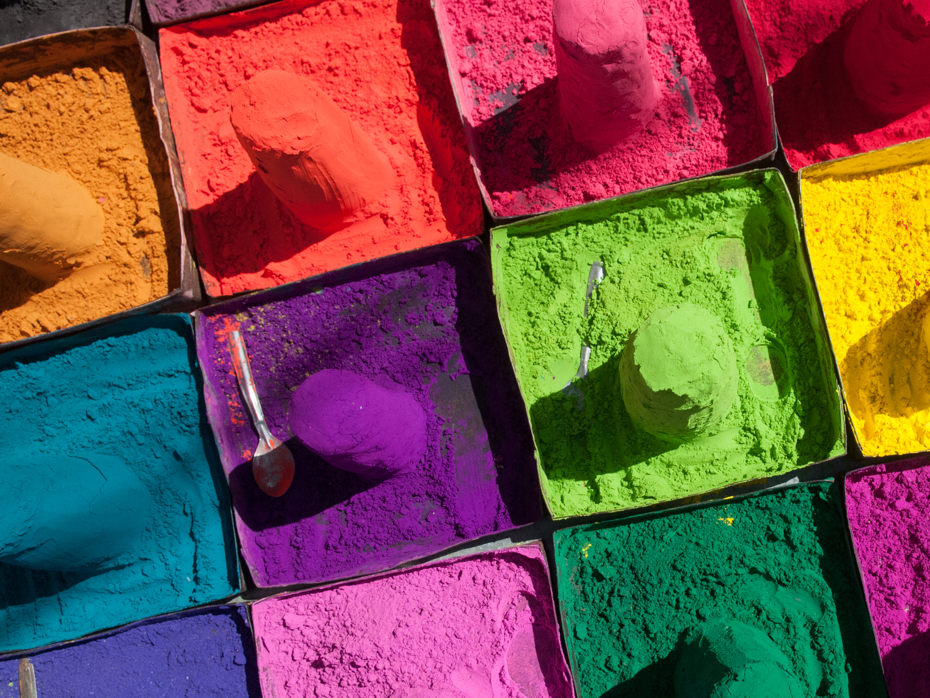
Competitive Advantage
CHIMERA
UNBOUND BY NATURAL LIMITS
Natural indigo manufacturing is limited by feedstock costs. Our technology allows us to convert cost neutral feedstocks into high value pigments.
GROW THEM ANYWHERE
Our resilient microbe produces faster than any other with low manufacturing costs
COST COMPETITIVE VS. SYNTHETIC
We own the IP for the lowest cost, natural pigment manufacturing technology.

Slide 6
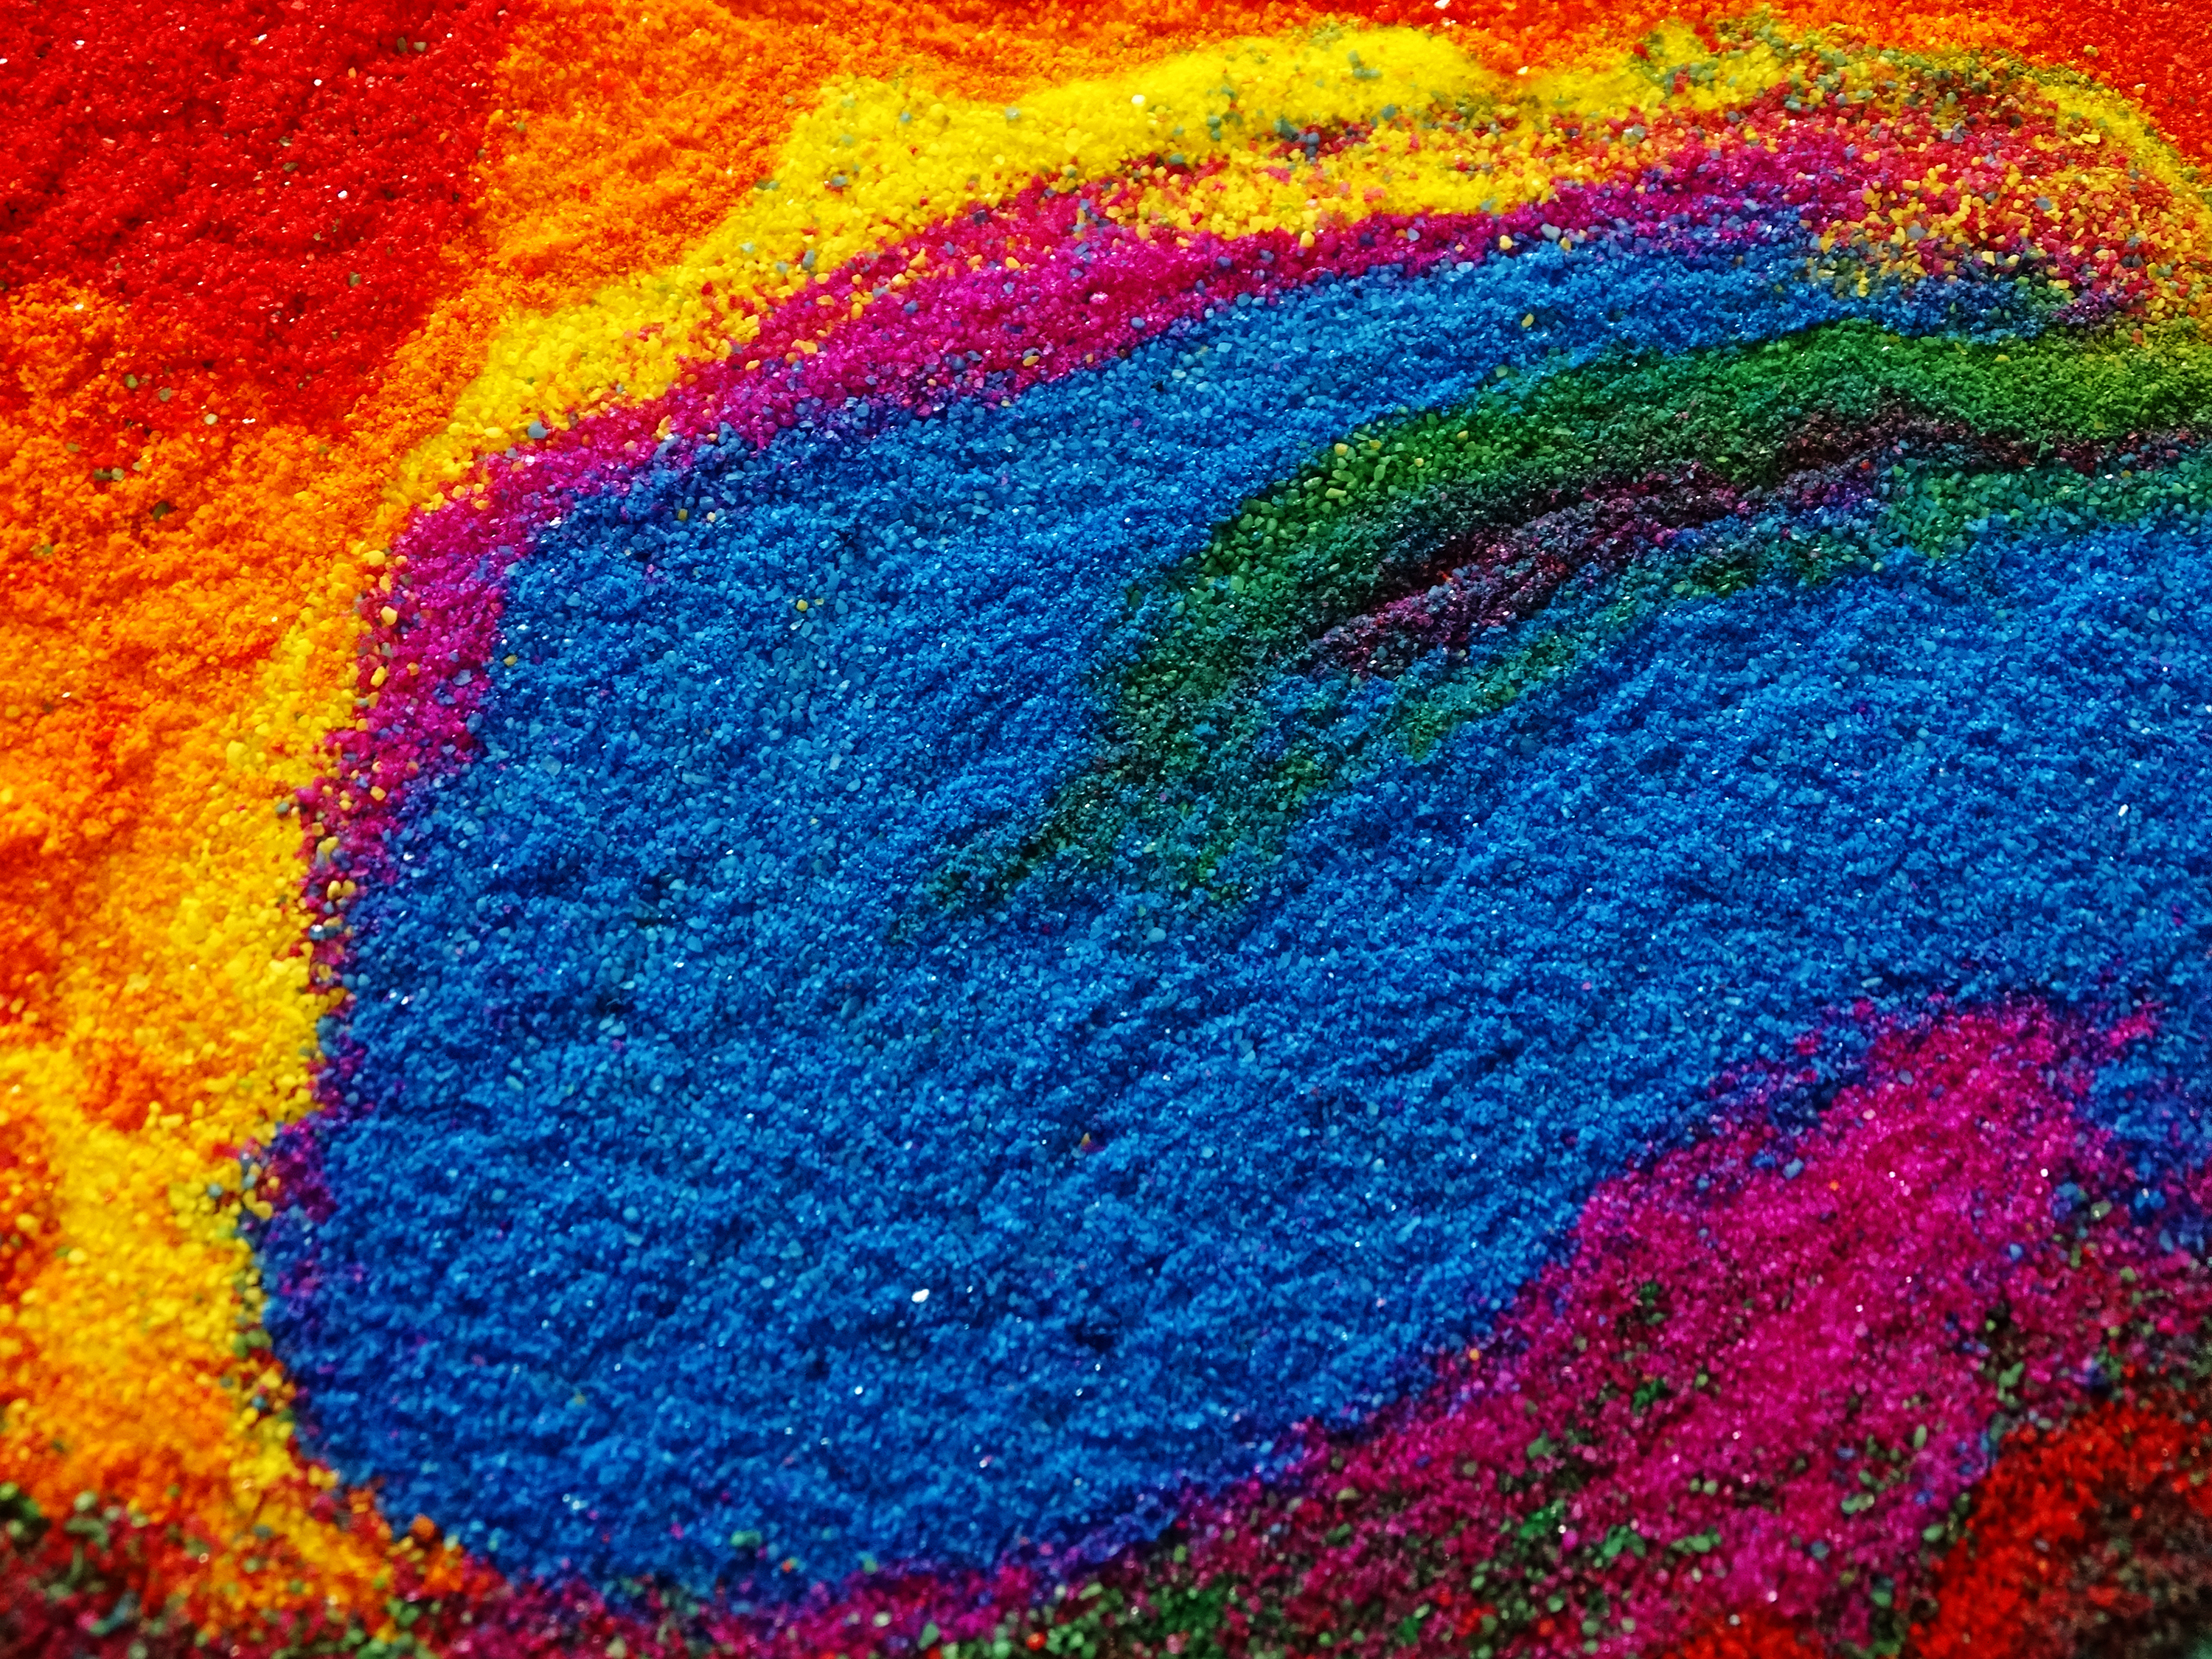
Why Now?
CHIMERA
MANUFACTURING NIGHTMARE
Supply chain interruptions in adversarial geographies have driven manufacturing costs up.
75% of world supply is from China from four producers.
TALENT AND ASSETS ARE AVAILABLE
Biotech bear has made the assets and talent required to rapidly iterate and get to market cheap and available.
TIME TO INNOVATE
Archaic manufacturing practices have left the industry ripe for innovative disruption. AI enzyme optimization accelerates technical development.

Slide 7


CHIMERA
Why Us?
Our Team
Our Experience
Andrew Stewart
CEO/CTO
Founder
20+ years
of combined senior/ executive
operational experience
15+ years
of biotech and fermentation
applied R&D experience
50M+
Deployed capex
500+
Managed employees
10+ years
with the foundational technology
Milad Moshfeghian
Founder
5+ years
of technical and innovation driven commercial experience

Slide 8
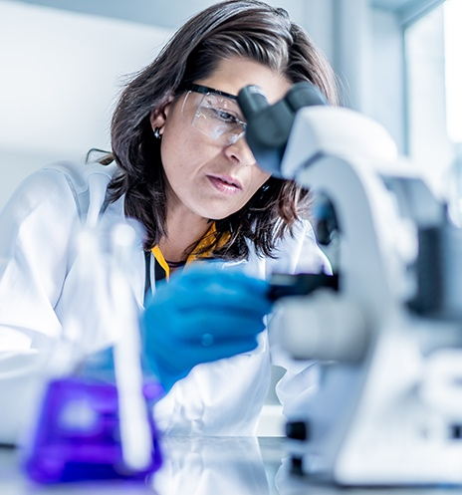
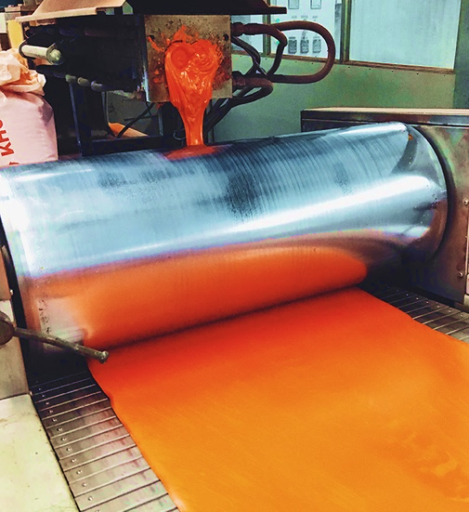


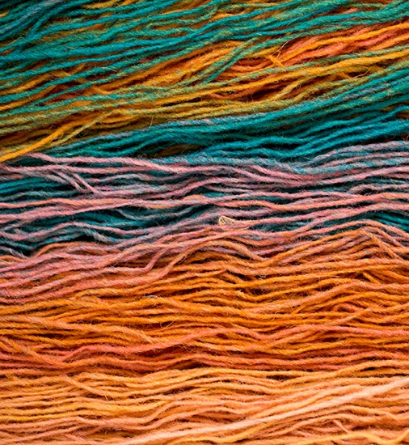
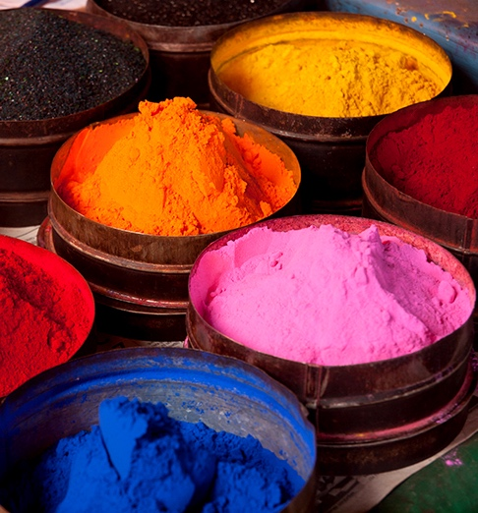
Traction
CHIMERA
PERSISTENCE
Developed a strain ready for production scale up.
REVENUE
$155,000
generated in less than
6 months of operation
PIPELINE
$1.5 Million
in scoped projects awaiting approval from alpha customer

Slide 9
CHIMERA
What’s Next?
TECHNOLOGY
Optimization of our strain to ensure efficient and high-purity indigo production
COMMERCIAL DEVELOPMENT
Sample testing with Alpha customers; Blue jean trials with 3 denim manufacturers
FUNDING
Bootstrapping has allowed for foundational development; capital injection will allow for faster tech and broader market development.

Slide 10
CHIMERA
andrew@chimerabioscience.com

