Slide 1


Presented by:
Kavin Gustafson
CEO Outcome Group
951-212-8603
kavin@outcomegroup.com
Delivering exceptional American-made aerial solutions
Notes:
I appreciate everyone here today, my name is Kavin Gustafson and I’m very excited to introduce Outcome Group and tell you about the customer pain points we are addressing in the drone market!

Slide 2
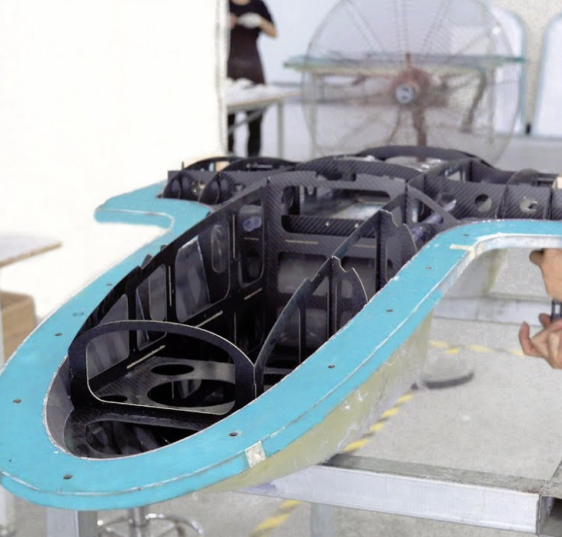
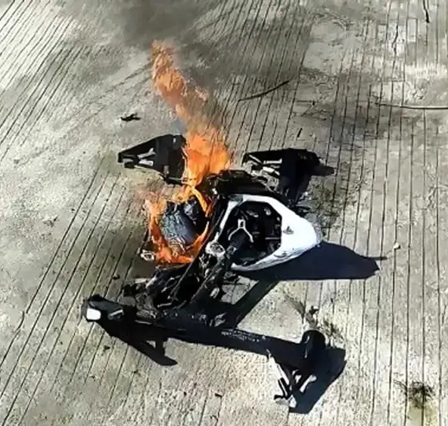
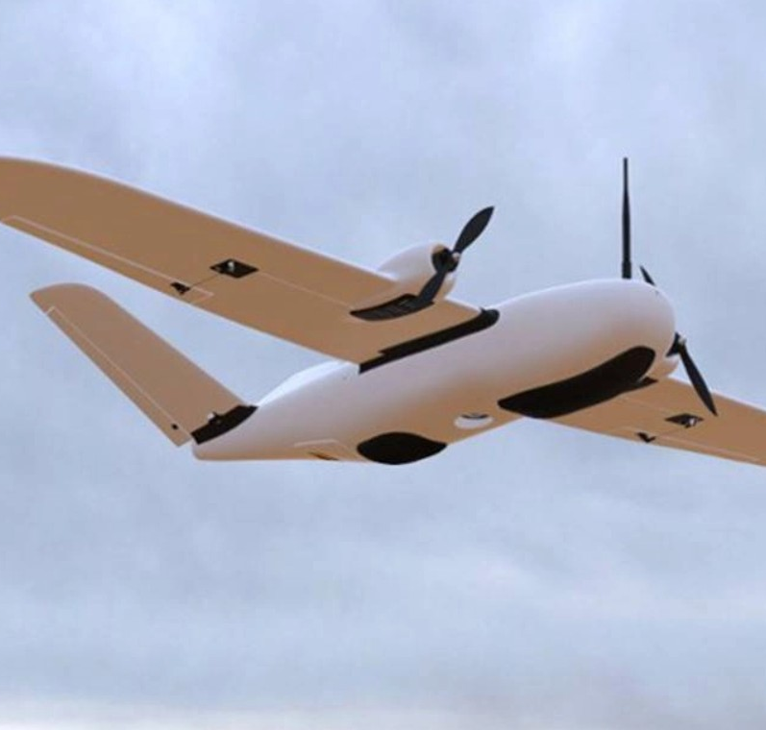
Gaps in the U.S. Drone Ecosystem
Gaps in supply chain, production, and performance defeat mission-ready deployment.
No Viable Domestic Production
Vehicle Performance Gap
Lack of AI Development Platforms
Notes:
What are these gaps? There is no viable domestic production of smaller fixed wing airframes (unlike the US quadcopter market, which is saturated). The airframes that are out there fall far short of the offerings from Europe and China. And none of the available airframes come equipped to address the need for AI development. Warfighters are not getting tools they need to face peer adversaries nor do commercial users have the tools to run their companies effectively.

Slide 3

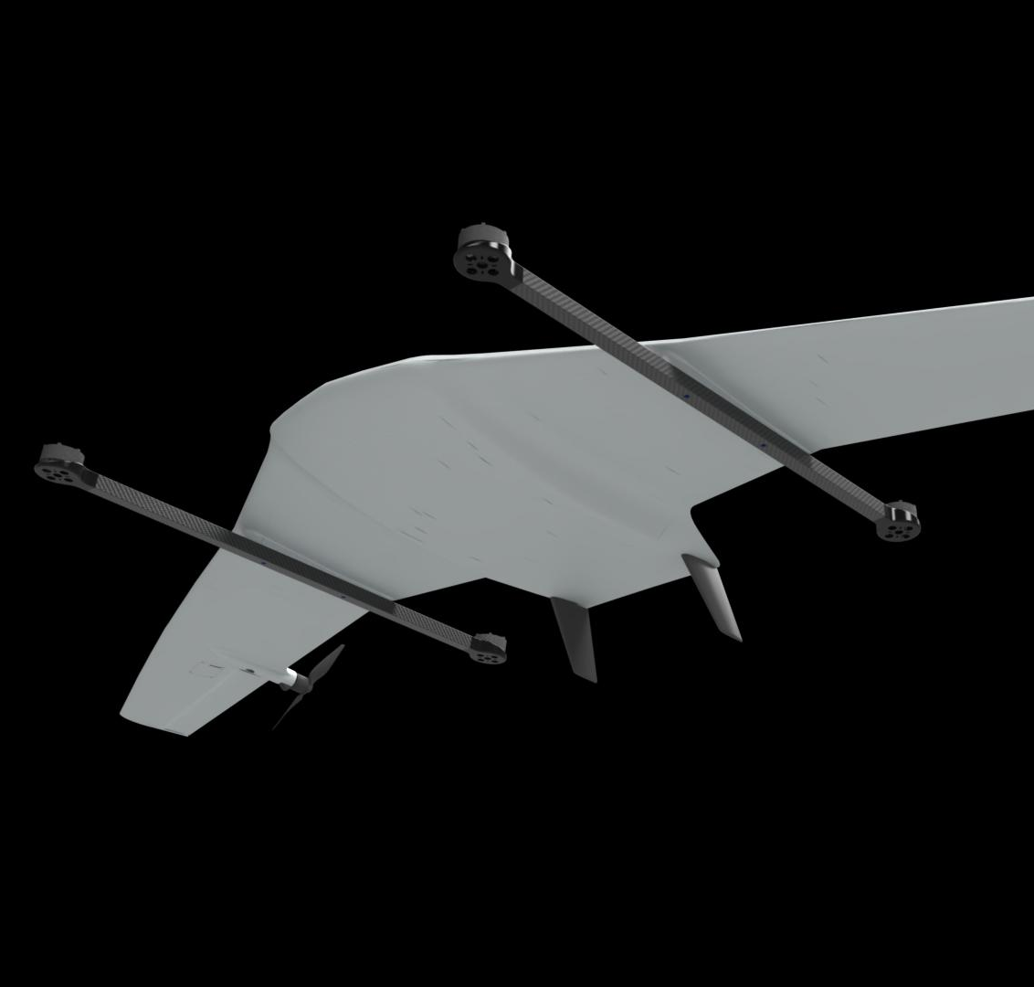
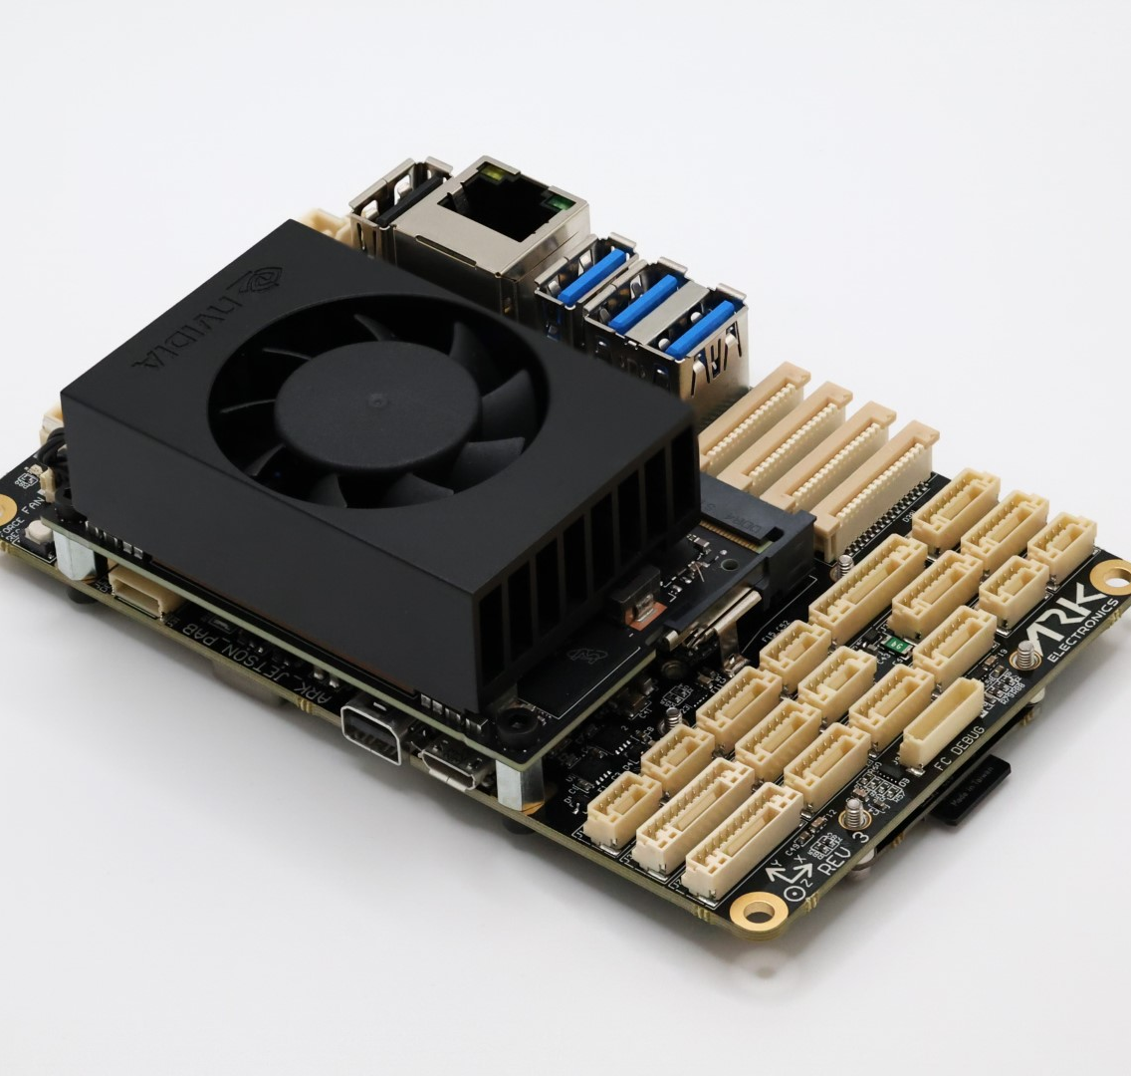
Building the Domestic Drone Stack
Integrated design, manufacturing, and AI-ready platforms built in the United States
U.S.-Based Manufacturing
Premier Modular Platforms
AI-Ready Hardware
Notes:
US based manufacturing protects the supply chain necessary to field these critical tools, and the premium performance platform maximizes the effect of the latest customer AI integrations and payloads. The hardware pictured here is the actual hardware that constitutes our product.

Slide 4
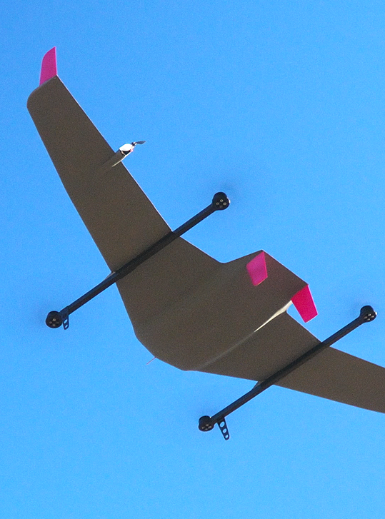
Payload Agnostic
EO • Thermal • LiDAR
E.T.A.
(Electron Transport Airplane)
Built for
Extreme Missions
AI Development Ready
Onboard AI Compute Hardware
COTS Hardware
Commercial Off-the-Shelf Hardware For User Servicing
MOSA Design
Modular Open Source Approach Maximizes Interoperability
4
Notes:
The heart of the product is the Ready-to-Fly Electron Transport Airplane using open systems that focus on maximizing mission flexibility. What if you didn’t have to design a new aircraft for every outcome? What if you could repair or reconfigure the aircraft yourself? This is becoming an expectation of customers; closed systems are rapidly losing their appeal.

Slide 5
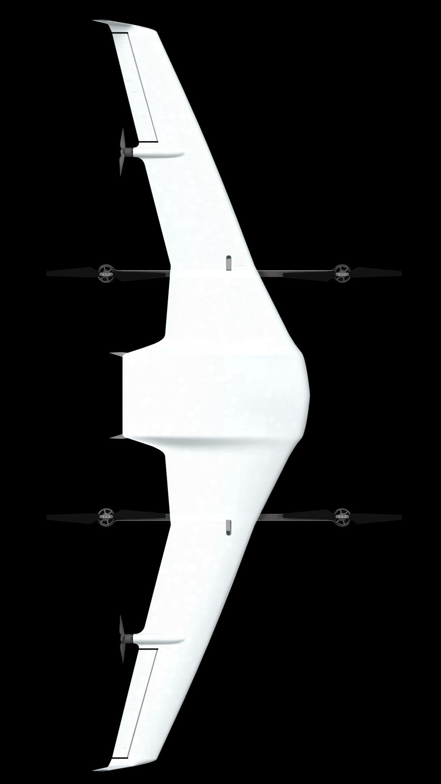
Seamless Adoption yet Difficult to Replicate
Network Effects/Low Adoption Barrier
Core Operating Software already has majority industry adoption
Protected Trade Secrets
Airframe design and construction is exceptionally difficult to replicate
Deep Domain Expertise
Ease of innovating ahead of the competition
Reputational Trust
Founding team has built a career in public
Notes:
The product is seamless to adopt yet difficult to replicate. The Core Operating System is open source and is the industry standard, making the transition to our product painless. The actual design and construction of the airframe is protected by trade secrets, reverse engineering is challenging at best. The teams deep domain expertise allows the us to continually be a step ahead of the competition, and the founder has demonstrated that domain expertise in public continually, building trust that can’t be bought.

Slide 6
Global Autonomous VTOL Market
A rapidly expanding dual use market with a focused entry point
$150B
Total Addressable Market (TAM)
$130-200B global drone market (2032)
Broader Drone Market
Serviceable Addressable Market (SAM)
$18-22B global VTOL market (2032)
Global VTOL Market With a 19-23% CAGR
$20B
$10B (1.2%)
Serviceable Obtainable Market (SOM)
$8-13B global fixed wing VTOL subset (2032)
Fixed Wing VTOL Dual Use Systems With a 23-24% CAGR, targeting 1.2% penetration of Serviceable Obtainable Market
Notes:
How big is the market being addressed? Its HUGE! The Compound Annual Growth Rate in each of the sectors allows for rapid growth even if you were unable to capture an expanding share in your market, which is very unlikely.

Slide 7


Competitive Landscape
Outcome Group leads in performance, flexibility, and domestic production
Key Differentiators: | Outcome Group | DeltaQuad | Quantum Systems | Wingtra
US Company, Made in the USA
4+ Hour Endurance
Open Edge Compute Capabilities
Easy Swap/Multi-Payload Capabilities
Notes:
Lets take a look at the Competitive landscape. As you can see, multi-payload capabilities are fairly standard across the spectrum. What is more difficult to achieve is the Endurance or On Station time most users are looking for, and everyone else has opted for closed development systems that frustrate AI development efforts. For some customers, having a US controlled company with a US designed and manufactured aircraft is non-negotiable.

Slide 8
Revenue Path and Scaling
Revenue roadmap driven by production scale and pricing
$2M
$70M
$300M
Beta Deployment
Initial scaling with beta airframes
Autonomy Stack Builders and Counter-UAS Test/Evaluation
Growth Phase
Production ramp, integrations and Programs
Program integrations and mission specific configurations
Full Scale Production
Multi Product Portfolio
Multi-sector dual use adoption
Path to Scale → Autonomy Stack Builders → Multi-sector/Product Expansion → $2M–300M/year
Notes:
How do we get to Revenue and start Scaling? Beginning with the simplest option, a Ready-to-Fly airframe that can be used without changes for Counter UAS Testing and Evaluation and also Autonomy Stack Builders, utilizing the built in Edge Compute Hardware. Further down the road, customer payload and autonomy integrations begin to take the lead in revenue, while also meeting the needs of larger program contracts. Multi product/multi sector expansion drives exponential growth.

Slide 9



Go-to-Market Strategy
Pilot-driven adoption through AI stack developer partnerships and operational deployment
Strategic Access
Pilots & Partnerships
Build DoW subcontractor partnerships
Establish prime contractor pathways
Early Customers
Partner with AI developers, Prime R&D departments
Refine platform through early partnership feedback
Program Capture
Mission Demonstrations
Share operational performance data
Highlight mission outcomes and reliability
Program Engagement
Support requirements development
Position platform for program adoption
Deploy & Scale
Operational Deployment
Deliver initial mission systems
Establish sustainment and support
Expansion
Convert pilot deployments into programs of record
Expand procurement across agencies and sectors
Notes:
Going to Market starts with AI Autonomy Stack Developers and Counter UAS Teams. Establishing a reputation for performance allows for larger programs within Primes and the Department of War.

Slide 10
Financial Outlook (5-Year)
$120M
Revenue growth with a path to early profitability
$75M
$45M
$10M
$2M
2026
2027
2028
2027
2028
Early program wins drive scale to ~$100–120M revenue with strong margins
Notes:
Revenue comes in early, beginning with the first 30 beta airframes. Later scaling will require future funding but much of the growth is carried by sales with a 50-60% profit margin.

Slide 11
Traction & Milestones
Technical validation and commercial progress
Company Founded
Initial design + concepts
Q3 2025
Concept Validation
Performance metrics demonstrate category leader
Q1 2026
Delivery
First aircraft delivered
Q2 2026
Funding for Expansion
Multi-Product/Multi-Sector
Q2 2028
R&D and Testing
4 prototypes built + tested
Q4 2025
In-Revenue
Initial design + concepts
Q2 2026
Scaling
30 beta units + $2M revenue
Q3 2026
$10k
$50k
$65k
$2M
$10M
Notes:
To date we have raised 125K from family and friends while building out 5 airframes along the path to validation. Our first customer wasn’t even willing to wait for a production version. Performance data demonstrates we are the category leader in all the nerdy stuff aerodynamicists care about and customers appreciate the “range anxiety” reduction.

Slide 12
The Ask
7%
Buffer
6%
Marketing
+ Sales
Seed Equity Financing Round
$2,000,000
17%
Team Expansion
50%
Manufacturing & Production
Scaling U.S. manufacturing, advancing platform performance, and accelerating deployment of mission-ready systems.
20%
Deployment & Operations
$125K Raised From Four Investors
Sales &
Marketing
25%
Notes:
We are asking for $2M in Equity Financing. Use of funds leans heavily into manufacturing setup and making the first 30 units. The other major uses are Operations and Team Expansion.

Slide 13




Our Executive Team
Kavin Gustafson
Chief Executive Officer…....
Former Chief Innovation Officer at Starling Inc. (patents filed), Atlas Loitering Munition Lead at Aevex Aerospace
TBA
VP of Business Development…....
TBA
Chief Technology Officer…....
13
Notes:
The executive team is me! Former Chief Innovation Officer at Starling Inc with patents filed, and the Engineering Lead on the Atlas Loitering Munition at Aevex Aerospace which just secured a 300-600M$ contract with the Army alongside Anduril. A fractional VP of Business Development and CTO are currently engaged as contractors.

Slide 14

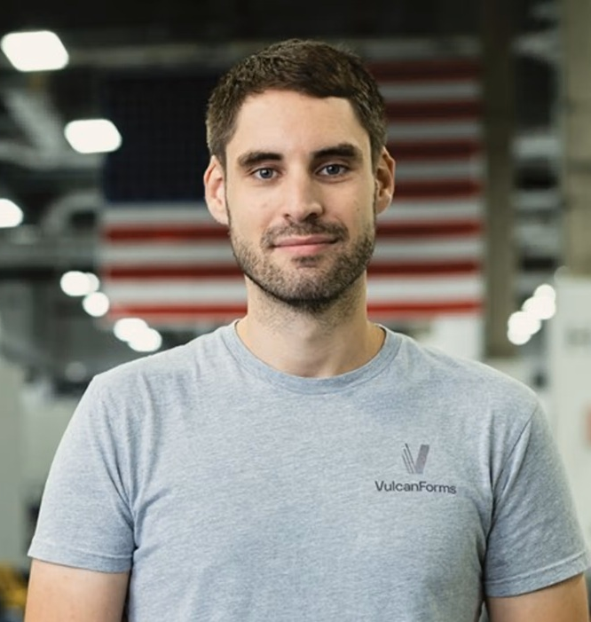





Our Advisory Team
Dan Fuller
Business Development Strategy Advisor
Former Sun Microsystems Executive
Manufacturing and R&D Leader at Insitu / Boeing
Martin Feldmann
Industrial Scaling Advisor
Founded and successfully exited Vulcan Forms, currently CEO at Stealth Startup
14
Notes:
We have an amazing pair of advisors, both built billion dollar companies in very different disciplines and we aspire to match their success.

Slide 15
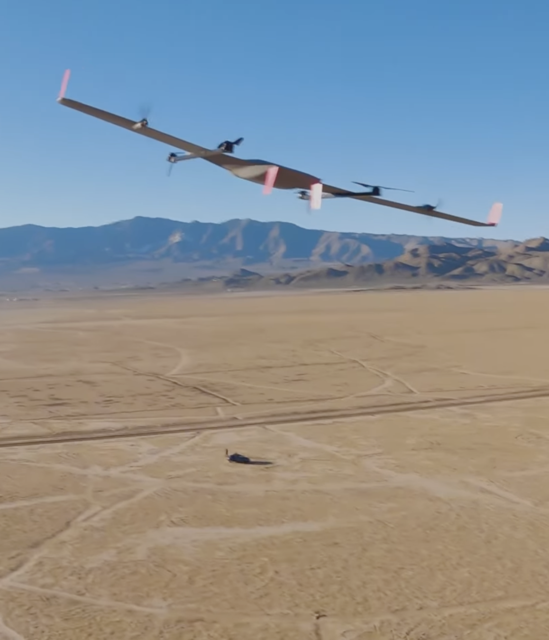

Mission-Ready U.S. Drone Systems
U.S.-Built, Resilient Supply Chain
ASK
High-Performance Modular Platforms
$2M Seed Round
Scale production of ETA platform
Expand payload integrations
Build leadership team
Scalable Production & Rapid Deployment
Presented by: Kavin Gustafson
CEO Outcome Group
kavin@outcomegroup.com / 951-212-8603
Attritable, Cost-Effective UAS Systems
Notes:
Outcome Group is building Cost Effective, High Performance Modular Platforms ready for AI Integrations, right here in the USA. Thank you for your attention, I’d love to answer any questions now:

Slide 16
Mission-Ready U.S. Drone Systems
U.S.-Built, Resilient Supply Chain
High-Performance Modular Platforms
Modular payload architecture, domestic manufacturing, and rapid deployment.
Scalable Production & Rapid Deployment
$2M Seed Raise
Presented by:
Kavin Gustafson
CEO Outcome Group
951-212-8603
kavin@outcomegroup.com
Attritable, Cost-Effective UAS Systems
Notes:
Outcome Group is building Cost Effective, High Performance Modular Platforms ready for AI Integrations, right here in the USA. Thank you for your attention, I’d love to answer any questions now:

