Slide 1

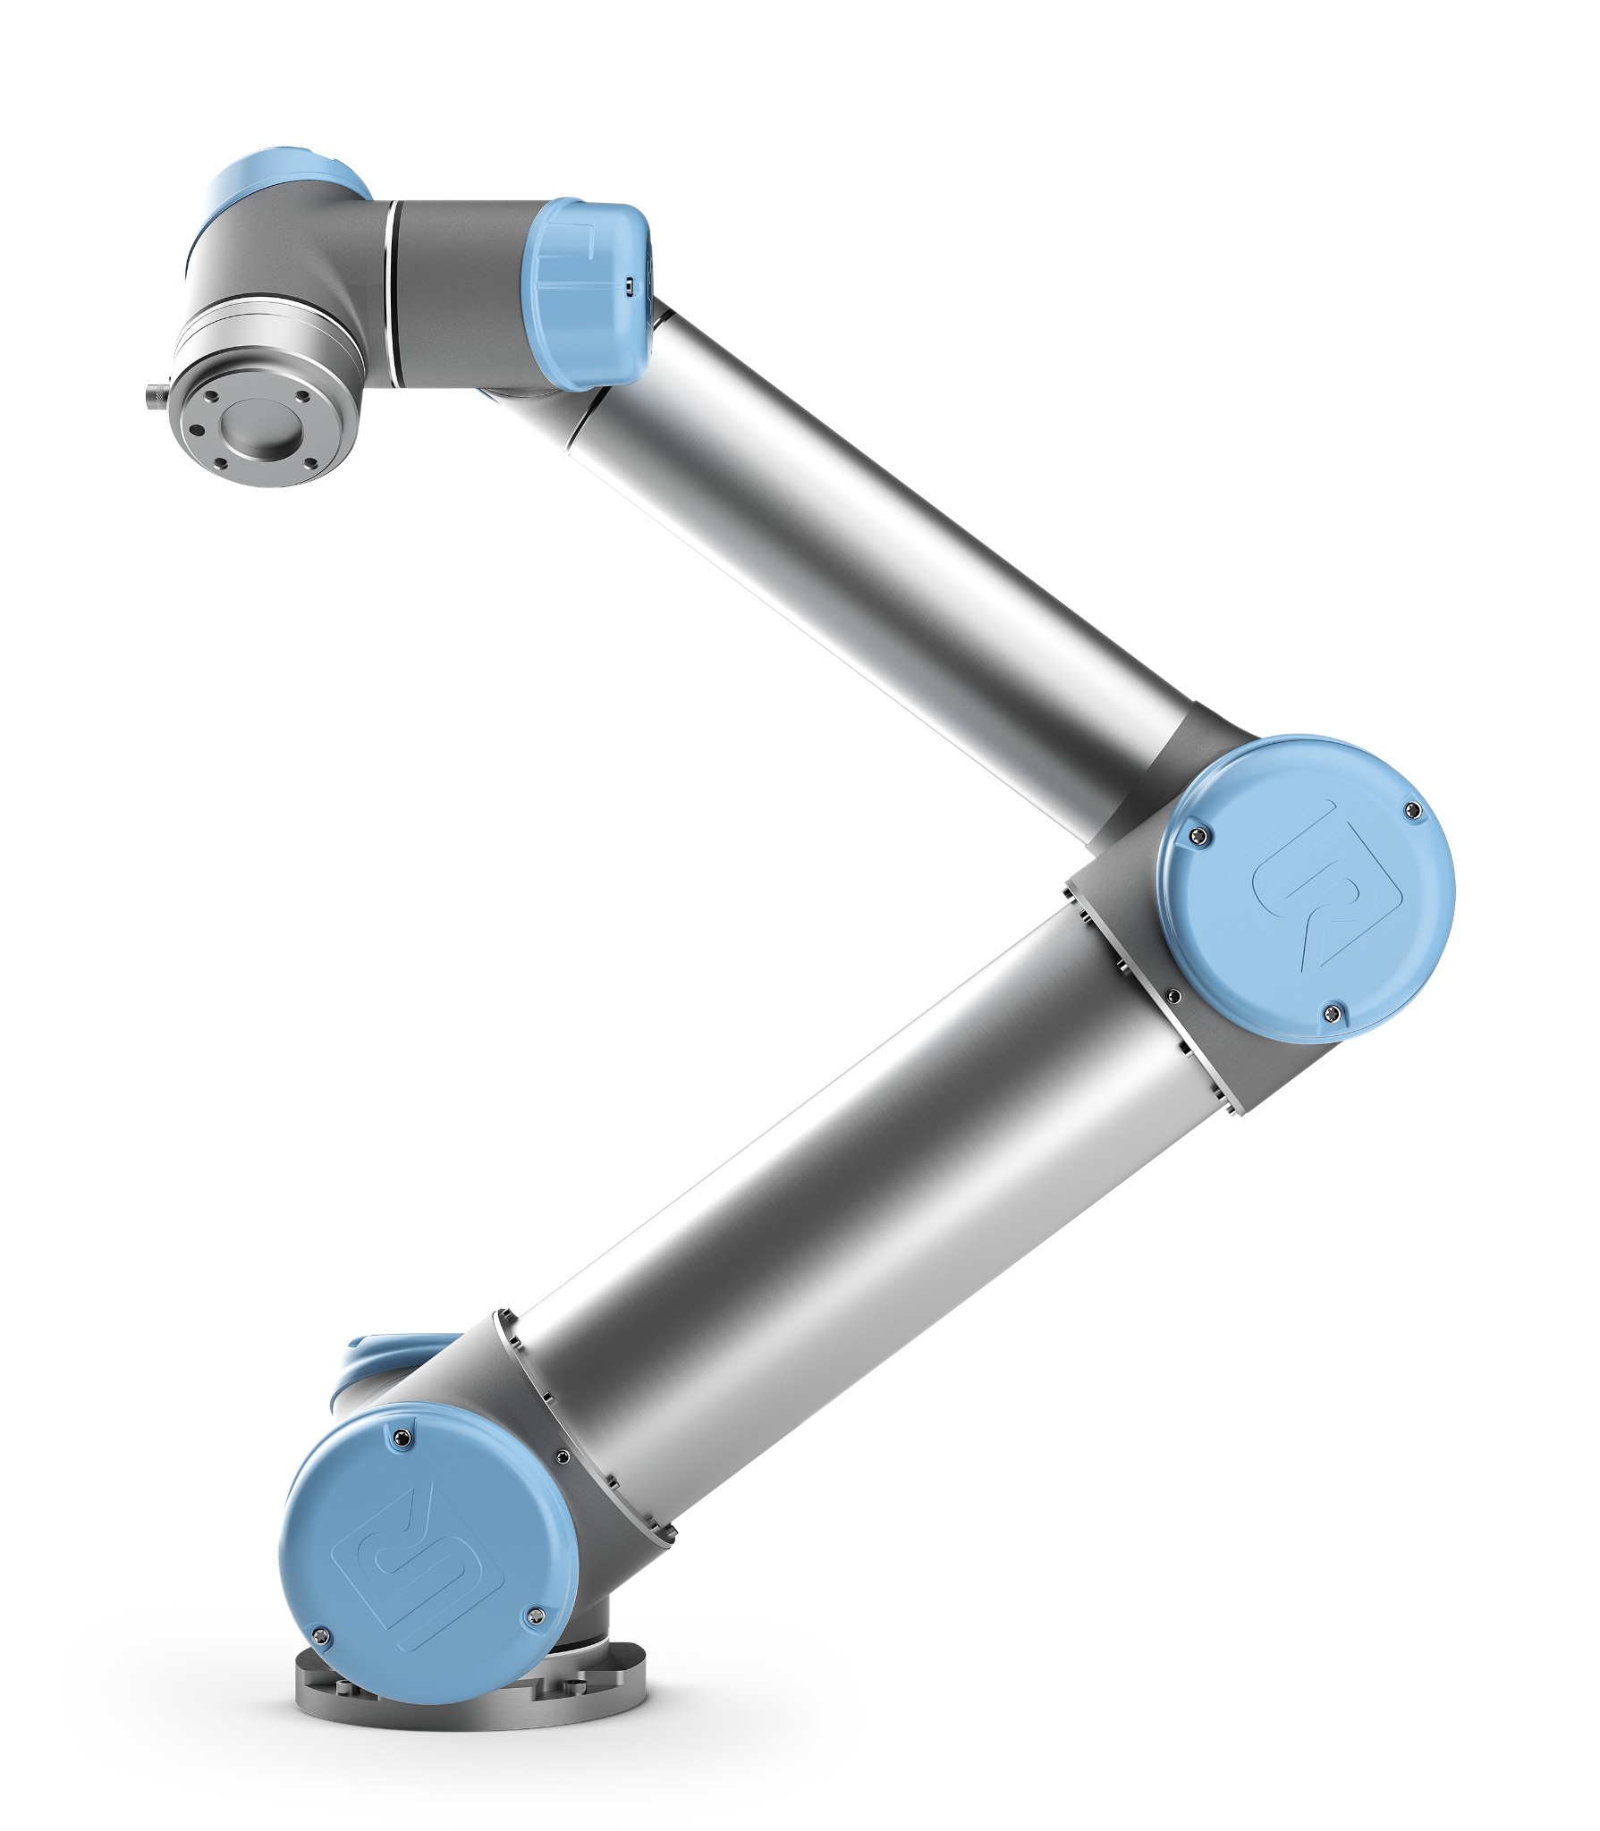
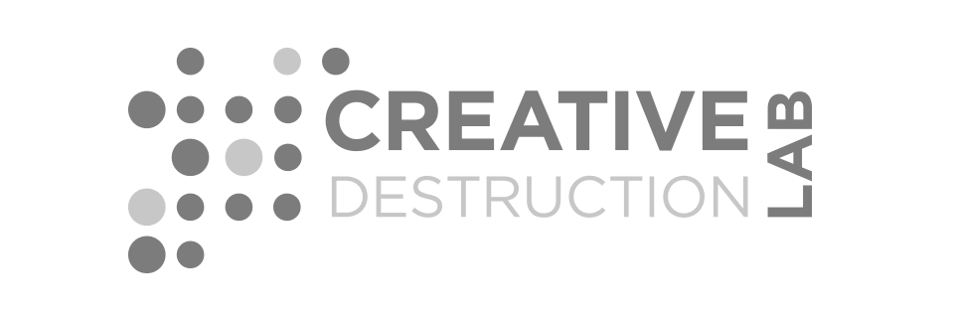




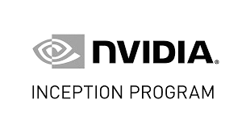
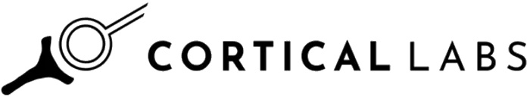
Biomimetic physical AI for better uptime and minimal reprogramming

Slide 2













What we are building
Neural intelligence-based robotic control systems. computationalised neural culture + Biomimetic algorithms
OMNI 00
Proxy model of neural intelligence for SKU agnostic manipulation without the need for retraining and better and more adaptive recovery protocols
We experiment on neural culture to better understand biological learning algorithms
We produce biomimetic algorithms combined with well known biomimetic algorithms
Runs on edge
Improved generalisability
Lowers Mean Time to Recovery (from failures)
Faster failure detection
Adaptable recovery protocols
Removes need for long programming times SKU agnostic manipulation without retraining Continual learning
We train neural culture to perform robotic control tasks in simulation
We computationalise the trained neural culture so it can run on edge and avoid reproducibility and scalability issues

Slide 3

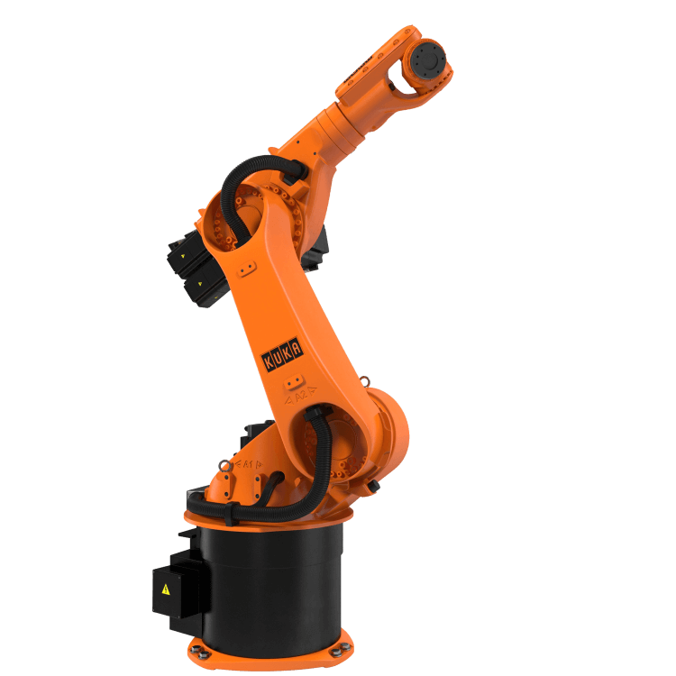
The Problem
Current robotic control systems lack adaptive recovery protocols (reducing uptime) and must be retrained to manipulate new SKUs
Manufacturers are moving towards customisable manufacturing but robots aren’t adaptive
Current robots have terrible failure and recovery protocols
Robots must be reprogrammed when a product selection changes
Customers want 100% uptime

Slide 4
The Solution
Biomimetic physical AI for better recovery protocols and manipulation of novel SKUs with no reprogramming
Lowering energy requirements (50x less energy) and lower data requirements in training (100x less energy)
Lower mean time to recovery, increasing uptime from 97% to 99.5%
Overall benefits of our technology
Massively improved data efficiency
Massively improved energy efficiency
Continual offline learning
No catastrophic forgetting
Massively improved generalisability
Our system can learn continually so robots do not need to be retrained when products change
We lower the OPEX needed to train generalised robotic control systems

Slide 5
Use cases and ROI
Use Case
Improved adaptive recovery protocols to improve uptime
Use Case
SKU agnostic manipulation without the need for retraining
Customers problem: Reprogramming and the need for SKU agnostic manipulation systems
Customers problem: Downtime
Many companies have changing SKUs and they
cannot retrain a robotic
control system every time a new product is added
Reprogramming is a major bottleneck for robotic adoption and requires specialist staff
An hour of unplanned downtime costs a company $135,000 (ABB) up to $2.2M. ($1.4T lost annually)
Current systems have 3% downtime
Industrial robots fail because they cannot adapt
A reprogramming specialists salary is £41519 annually (Glassdoor)
Current robotic control algorithms still suffer from the long tail problem

Slide 6
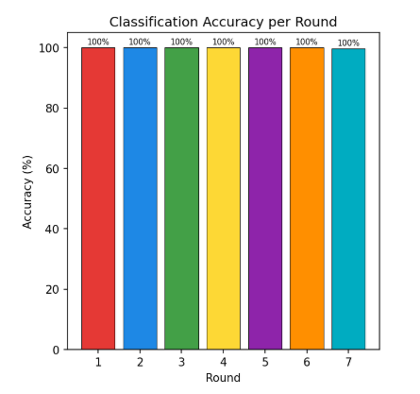
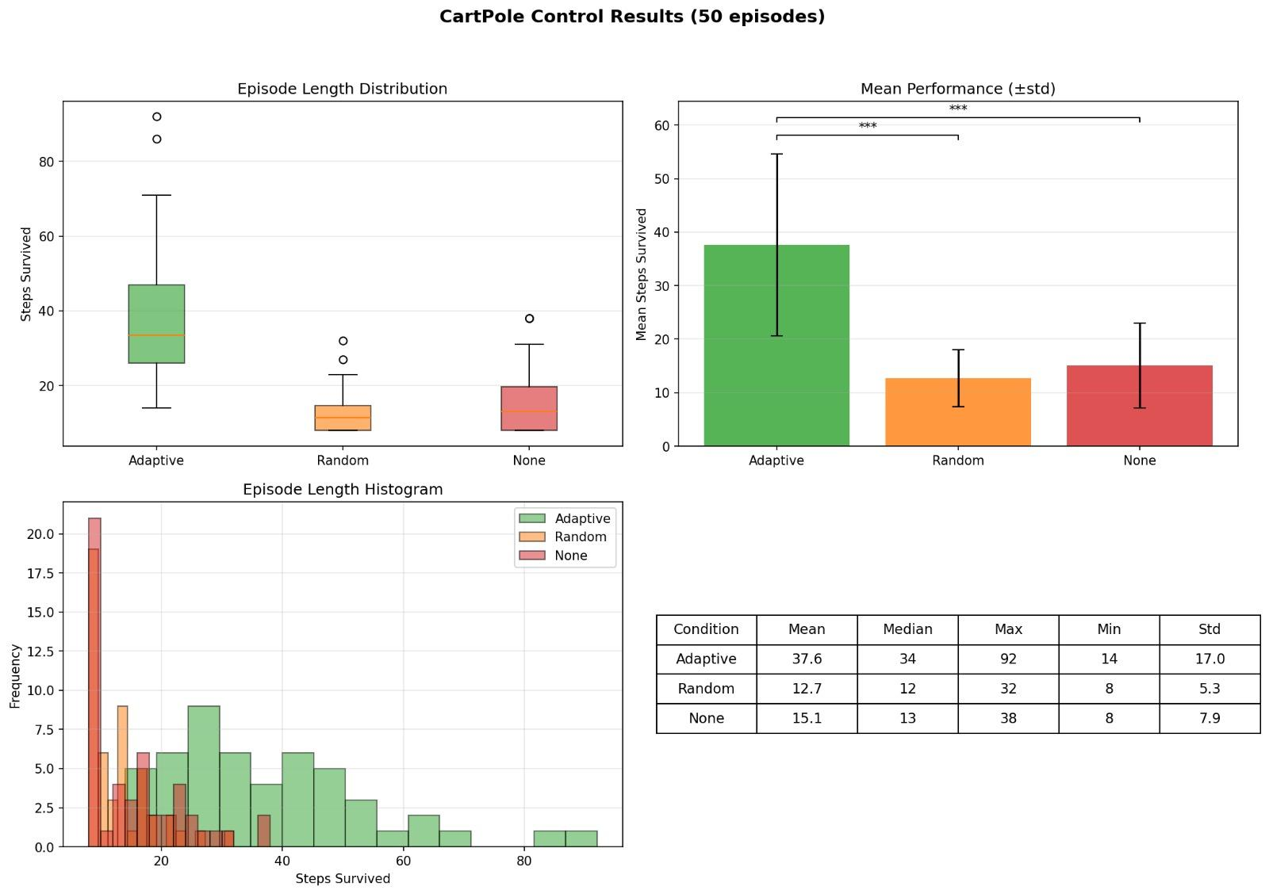
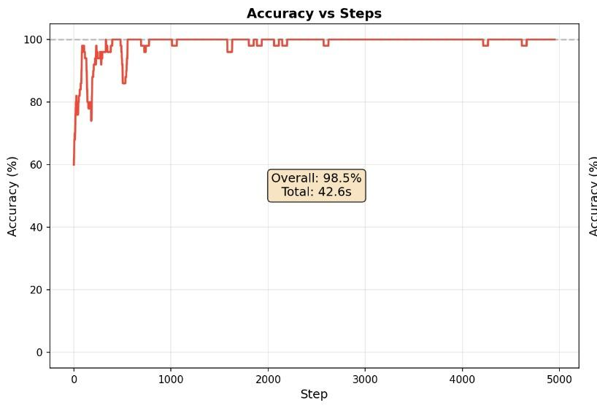
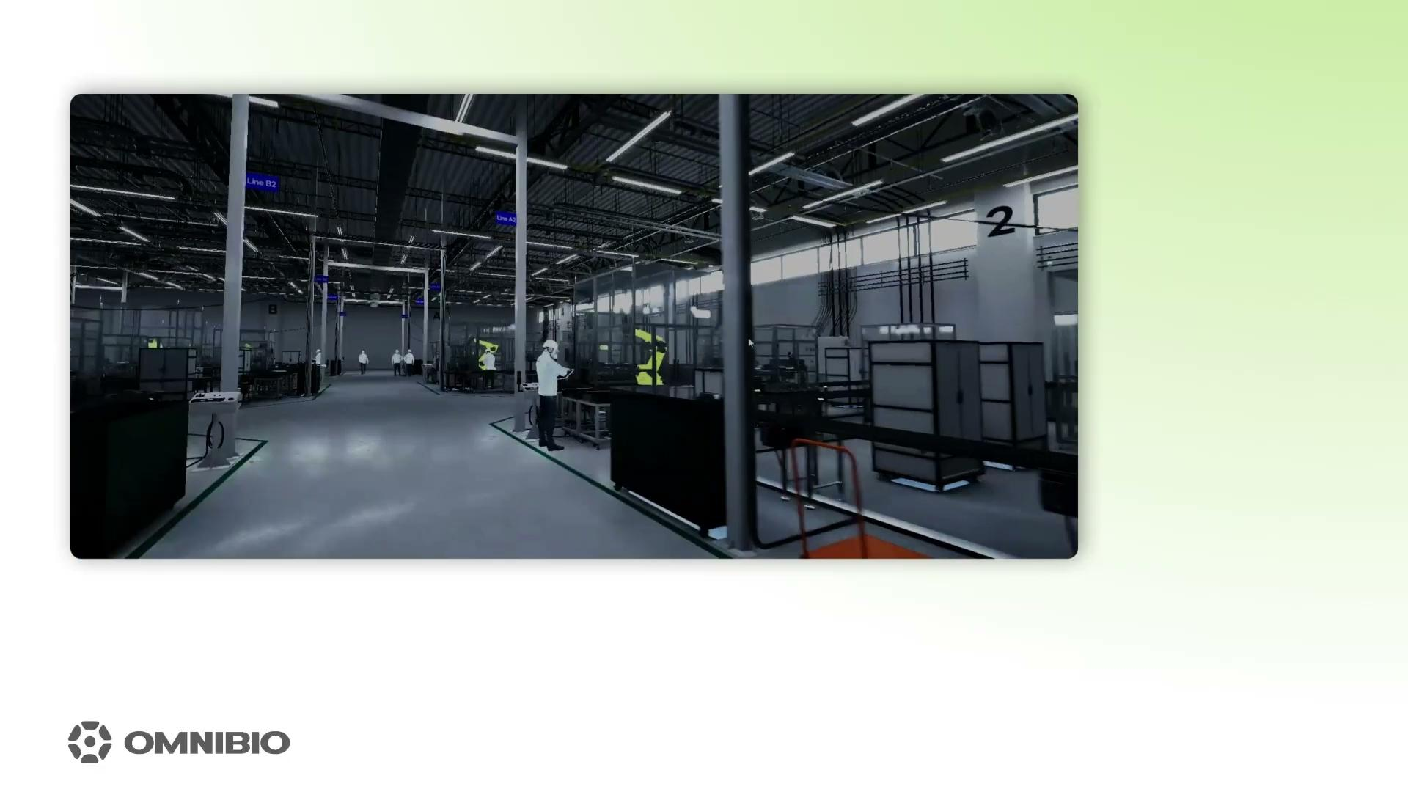
Key Results
US
The rest of the industry
Model was not trained on Cyan object
Sensor Encoding
SKU agnostic Identification
Computationalised Neurons
Generalised learning
Encoding environmental data From simulated robots with neurons
Proves that our system can identify SKUs which it has not been trained on and identify objects under random occlusion conditions
Proves that a trained biological neural network outcompetes an untrained network when computationalised. Also proves that neural cultures can be computationalised.
Proves that our agent when pre-trained in an environment, when moved into a different environment, learns faster
*More results available in results document

Slide 7
Market
$94.6B
TAM
Total Available Market
Robotic software + Robotic integration industry (2030: $196B)
$41.4B
SAM
Serviceable Available Market
Market that relates to industrial robotic arms (2030: $96B)
$1.9B
SOM
Serviceable Obtainable Market
Market in our target geographies (2030: $4B)

Slide 8

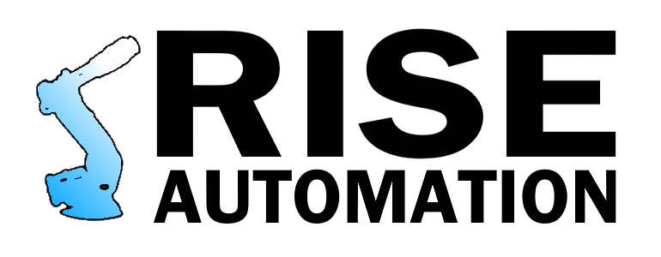
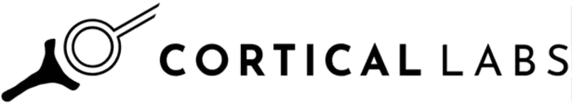
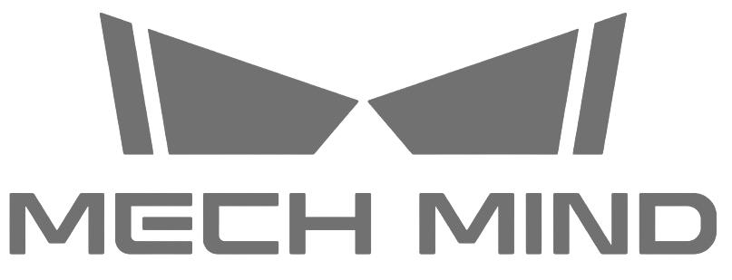
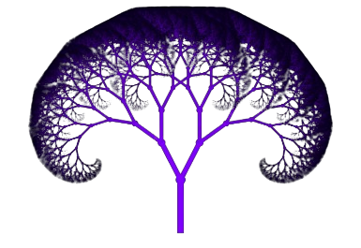
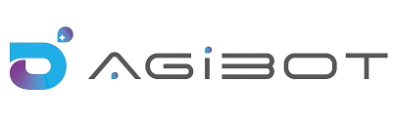
Commercial Traction
Kinematic Trees
LOIs
Partnerships
Early Conversations
Pilot study to pass sim to real gap
Expressed interest in distributing our software
Free access to their system and cultured neurons
We have been partnered for >12 months
Have offered to potentially pilot our software
Offered to push funding to us from the Innovate robotic hub grant they have applied for
Act as a system integrator and ship our software alongside their cameras
LOI to sell our software on their platform
White-label their robots and ship with our software

Slide 9
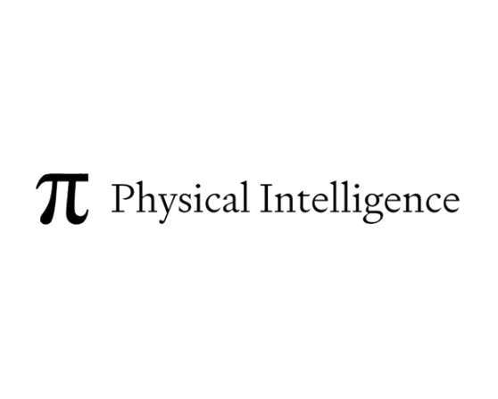
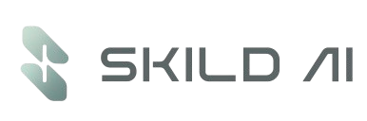

Our Positioning
Focus on consumer robots
Hardware focused
Platforms for biocomputing research
Right approach, no commercial application
Software focused
Uses unnatural learning, unadaptable, learning from dataset
Wrong approach
Train massive foundational models which are still restrained by training data. Data is costly and impacts training time. Training time is also long, reducing the ability to quickly add features/retrain.
Right approach,
using biomimetic algorithms on any hardware

Slide 10
Our product and commercial roadmaps
OMNI-001a
OMNI-001b
OMNI-001d
OMNI-001b
OMNI-001c
Sell modules
Sell via marketplaces
Acquisition
Pilot
Sell via system integrators and hardware suppliers
Product
Pick and place for different SKUs without the need for reprogramming
Failure recovery in mobile robots
Fine electronics assembly
Failure recovery in fixed robots
Flexible material manipulation
Commercial
Sell modules on Kinematic Trees’ platform
Universal Robots
and Igus RBTX
By major player
(KUKA, ABB, FANUC)
Pilot study with Rise Automation (Robotic integrator) and Portland Holding Ltd (SME)
AgiBot

Slide 11
Go To Market
Sell Software via System Integrator
Sell Software via Marketplaces
Robotic marketplaces allow third-party software vendors to distribute applications directly to their hardware customers.
Listing our software on these platforms gives us access to a large, captive user base and provides implicit trust, guaranteed hardware compatibility and a steady pipeline of qualified customers
Partnering with integrators provides scalable market access, since many end users rely on integrators to recommend automation solutions and lack in-house robotics expertise
Customers that have already made large CAPEX investments in a robot platform are unlikely to switch suppliers, and marketplace software further reinforces this lock-in.
As robotic tasks become more complex, failures and recovery times increase, creating a growing need for technologies that maintain uptime and system reliability
Target customers
RARUK, Rise Automation
Examples of this model working:
Sereact, Melli Robotics
Target customers
Universal Robots UR Marketplace, IGUS RBTX, Kinematic Trees

Slide 12

Data and Energy Benefits
Data
Energy
We use 50x less energy than current methods
The cost of collecting training data for robotics can be 10-100x the cost of GPU training for the model
Training Time
We use 100x less data than current method
The OpenX embodiment dataset is 9TB, to collect this data cost $900,000 - $4,500,000
Even small VLA datasets are large (OpenX embodiment is 9TB)
To train a VLA with 9TB would require a 8 GPU cluster to run for 6-20 days per epoch.
The cost for 8 in stances of a H100 from AWS costs $55 per hour to rent (Total cost $7920-$26400 per epoch).
To train a model comparative to OpenX we would only spend
$9000 - $4500
Result
This allows us to compete with Skild AI and similar companies on OPEX alone
To train a comparative model we would spend $79.2 -
$264 per epoch

Slide 13



IP Strategy
Patent Structure Functional blocks | Patent attorneys we are in talks with
Proposed patents Functional blocks necessary for producing neural intelligence-based robotics Functional blocks for AIF enabled SKU agnostic manipulation Functional blocks for AIF enabled multi-robot coordination
Patent Geographies | Risk Mitigation | Steps completed
UK, Japan, EU, USA, China, South Korea | Company documents only available to founders Source code encrypted and password protected NDAs and IP assignments for all staff | FTO search Attorneys proposed patent structure and timeline

Slide 14

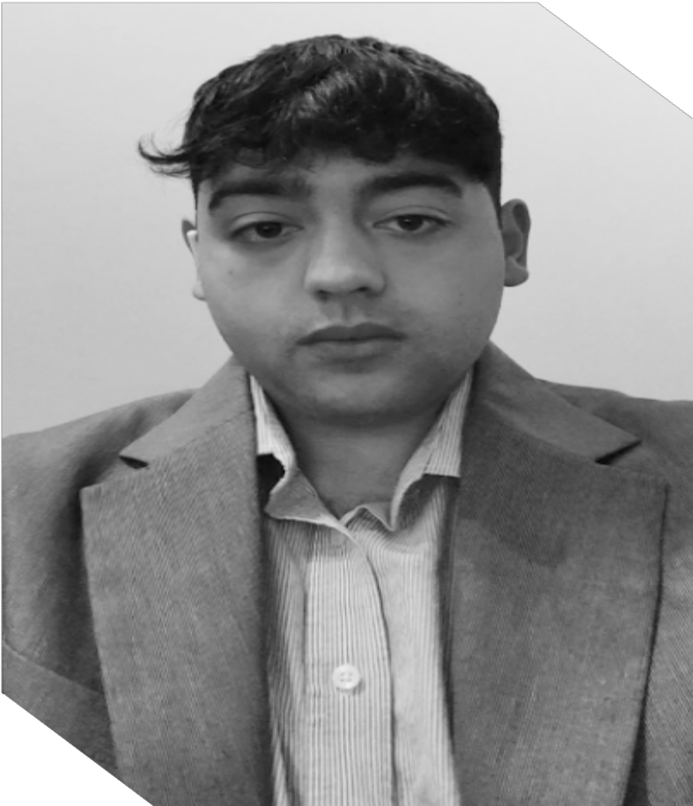
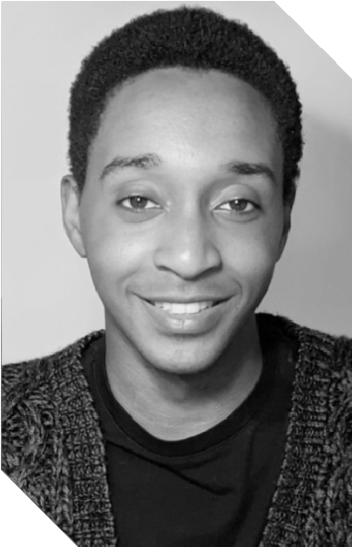


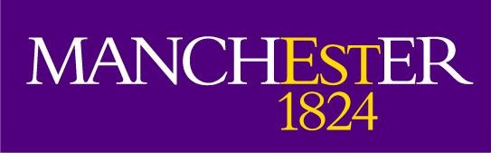

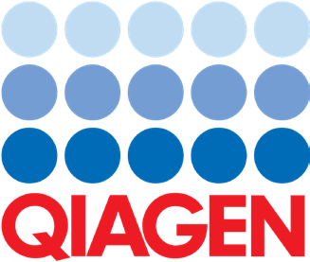
Team
CEO
David Yacoub
Cell Culturing, Genetics
CTO
Robert Clarke
Neural Signal Processing | AI/ ML
Cell culturing lab owner at age 23
Ex-QIAGEN
BSc in Biotechnology, Mphil in Bioscience Enterprise
Built B2B/B2C smoking consumables business at age 19 (>£250,000/pa turnover)
Worked on neuromorphic algorithms for >5 Years
PhD in brain computer interfacing, MSc in Cognitive Robotics
One of the first researchers to gain access to FinalSparks OI system

Slide 15

















Ask
Pre-Seed
£3,500,000 ($4,675,000)
OMNI-001a Developed
OMNI-001b Developed
Unpaid Pilot Completed
Co-Development to pass sim-to-real Gap completed
Paid Pilots Completed
Reach TRL-8
Set up own laboratory
Use of Funds
Staff
66.3%
IP
3.9%
Lab
11.1%
Compute
14.0%
Accountancy
0.1%
Hardware
3.0%
Legal
1.6%

